Slide 1
Underwriting Best Practices
eApp Instant Communication
National Life Group® is a trade name of National Life Insurance Company, Montpelier, VT, Life Insurance Company of the Southwest, Addison, TX and their affiliates. Each company of National Life Group is solely responsible for its own financial condition and contractual obligations. Life Insurance Company of the Southwest is not an authorized insurer in New York and does not conduct insurance business in New York. This presentation may not be recorded, copied, transmitted or otherwise disseminated without the express written permission of National Life Group.

Slide 2
eApp Enhanced
with Instant Communication
Straight-through processing now includes Instant Communication
Applicants can receive Instant Communication regarding approval or additional requirements at the time of application
This presentation includes a few tips to increase the chance of an application receiving Instant Approval

Slide 3
Common Reasons Apps Do Not Qualify for Straight Through Processing
X
Medications or medical conditions are typed free-form into the eApp
X
Primary Care Physician last visit details are missing
X
Reason for last consultation is missing
X
Inaccurate height/weight for juveniles
X
Juvenile exceeds maximum allowed face amount (>$1MM) – see next slide for more information

Slide 4
Common Reasons Apps Do Not Qualify for Straight Through Processing:
Juvenile Face Amounts
▶︎
Juvenile exceeds maximum allowed face amount (>$1MM)
▶︎
Siblings are not equally insured
▶︎
Juvenile applied for insurance is > the insurance for both parents. At least one parent should have the same or greater applied for/inforce coverage.

Slide 5
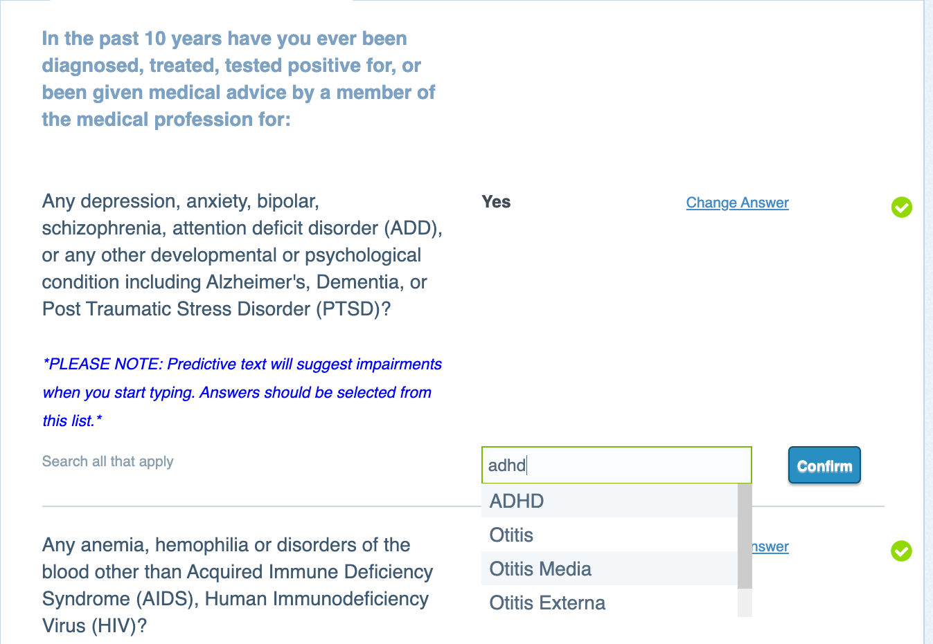
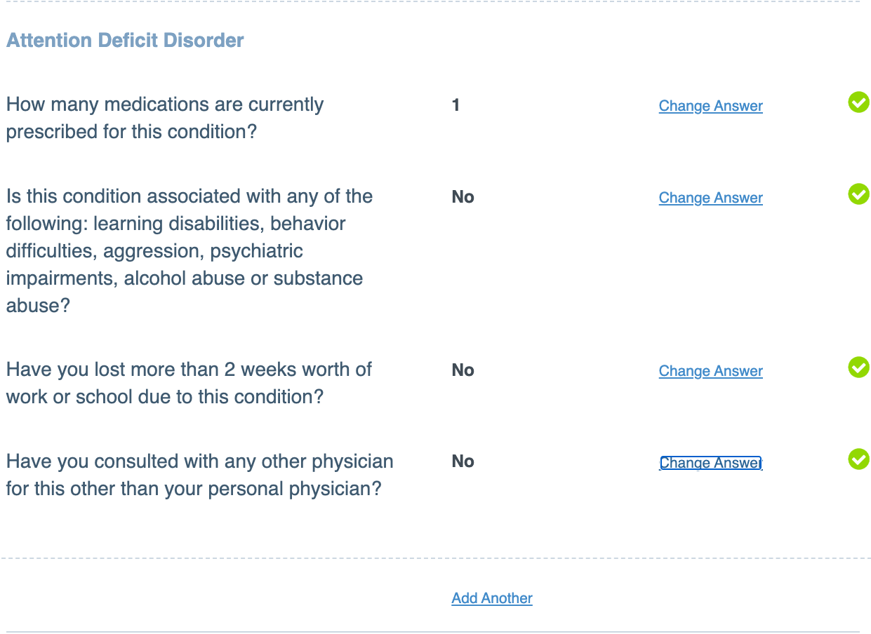
Common Reasons Apps Do Not Qualify for Straight Through Processing:
Medical Conditions are Typed Free-Form into the e-App
What can you do differently?
▶︎
Choose from the drop-down boxes whenever possible.
▶︎
For medical conditions, select from the predictive text drop-down.
Note:
If there are multiple conditions, select “Add Another” and a new drop-down will populate.

Slide 6
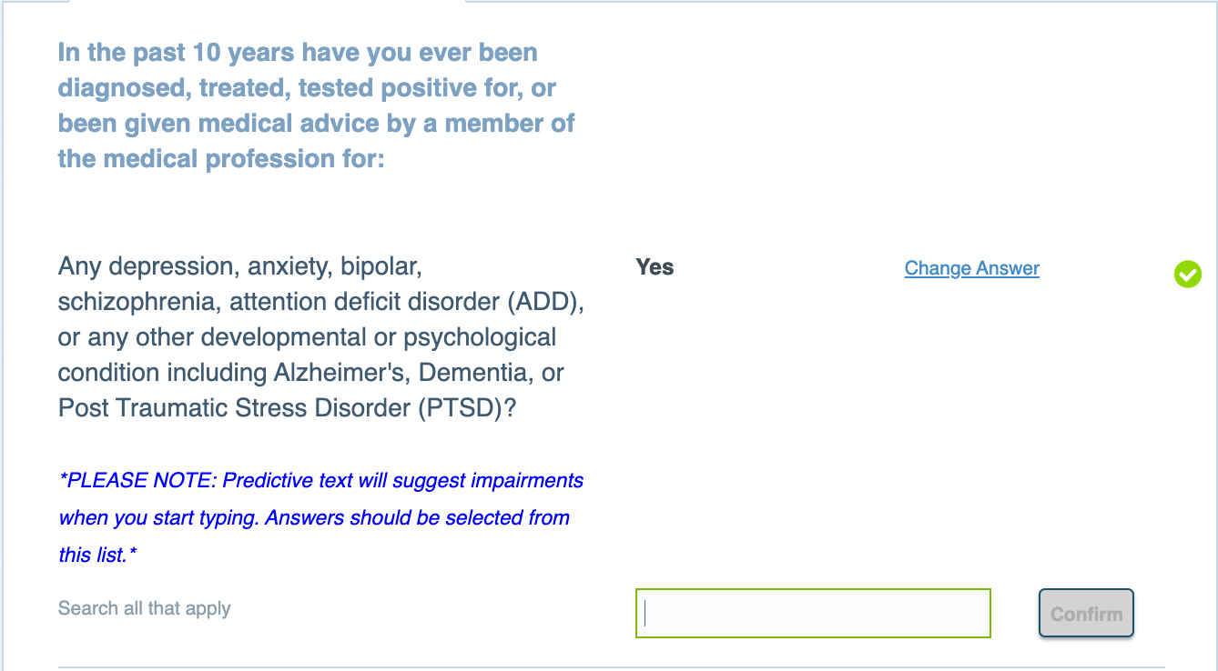
Common Reasons Apps Do Not Qualify for Straight Through Processing:
Medication Information is Included in the Medical Conditions Question
What can you do differently?
▶︎
For the “medical conditions” question, choose a condition.
▶︎
DO NOT include medication information in the text field.
Do not include medication information here!

Slide 7
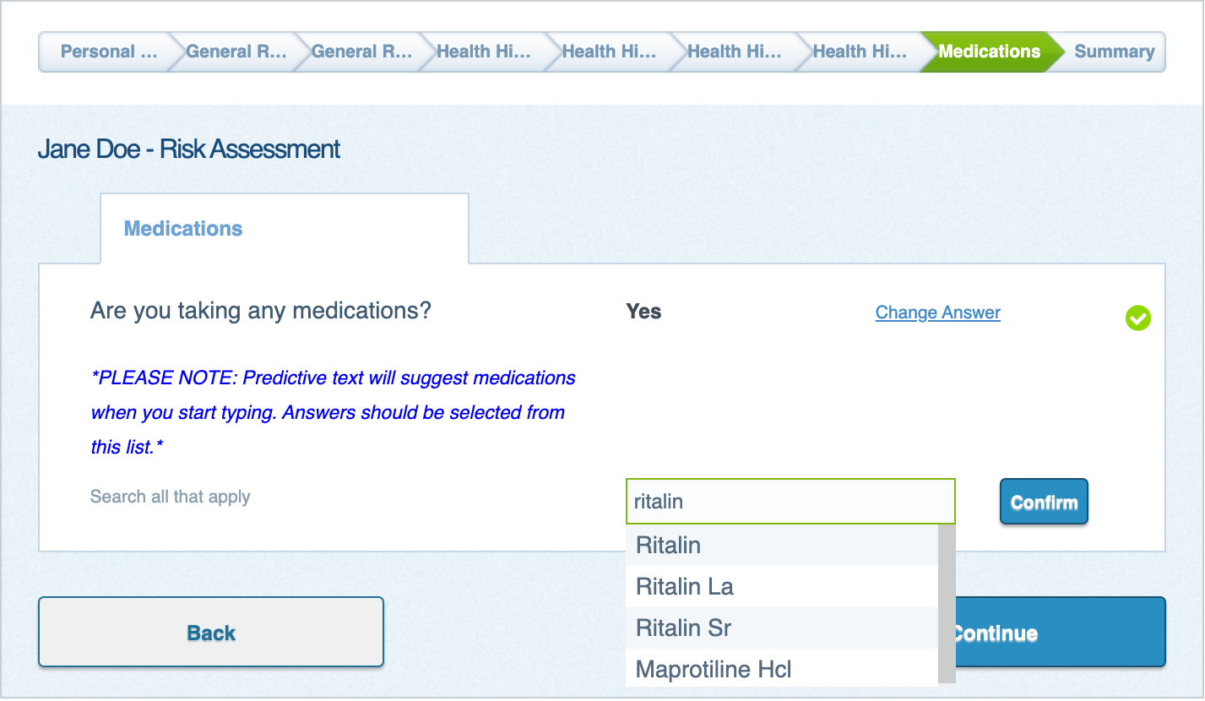
Common Reasons Apps Do Not Qualify for Straight Through Processing:
Medication Dosages are Included in the Medical Conditions Question
What can you do differently?
▶︎
Medications should be selected from the predictive drop-down list in the “Are you taking medications” question.
▶︎
DO NOT include medication dosages, e.g. “10 mg” or “2 times per day”, in the text field.
▶︎
Keep in mind, the application is designed to ask the questions we need an answer to, so if dosage information is necessary, the app will ask for it. This is another reason we get HIPAA signed early, so we can harness the power of third party data to cut back on asking unnecessary questions.
Do not include medication dosages here!

Slide 8
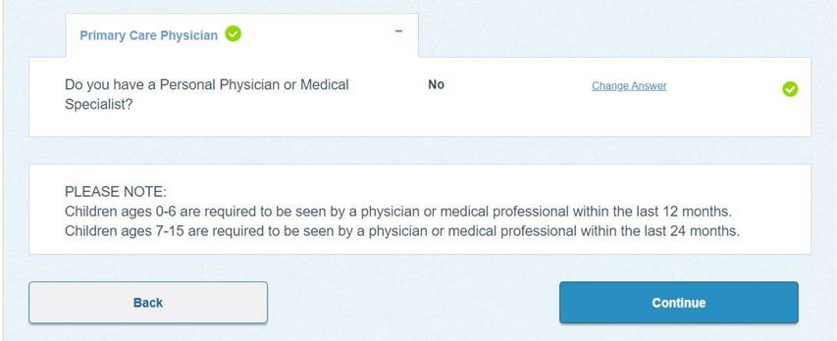
Common Reasons Apps Do Not Qualify for Straight Through Processing:
Primary Care Physician Last Visit Details are Missing
What can you do differently?
▶︎
Children 0-6 must be seen once every 12 months.
▶︎
Children 7-15 and Adults 60+ must be seen once every 24 months.
▶︎
If the primary care physician is not listed for juveniles under age 16 or if they don’t meet the guidelines outlined within the help text, the case will not qualify for Straight Through Processing.
Make sure you watch for the help text when answering the questions.

Slide 9
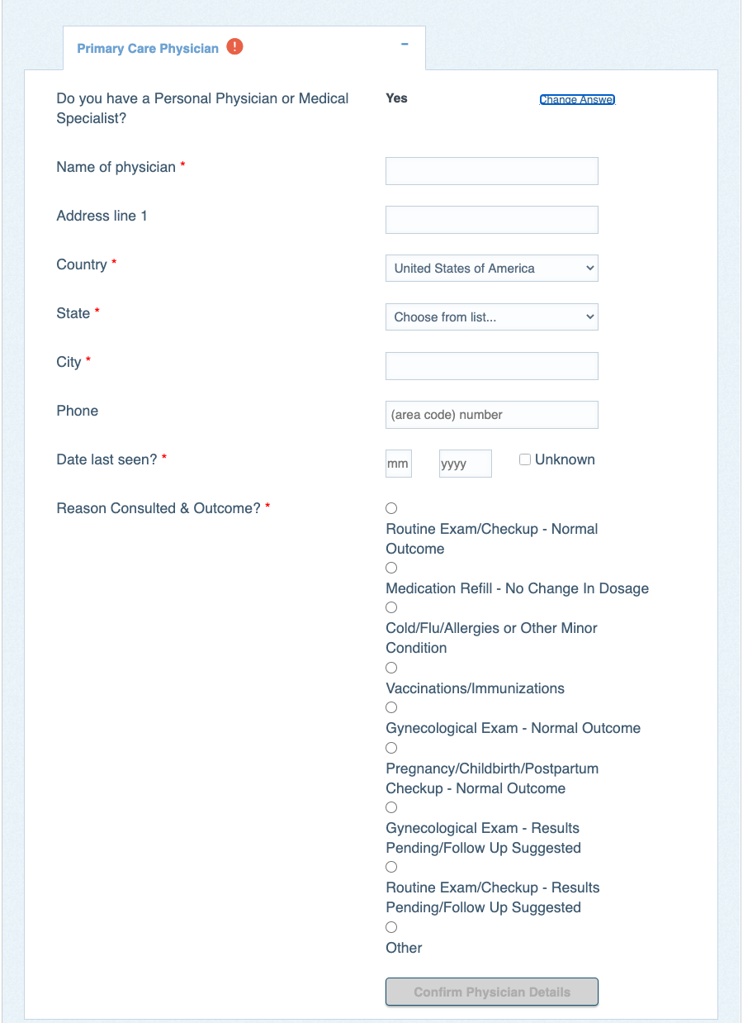
Common Reasons Apps Do Not Qualify for Straight Through Processing:
Reason for Last Consultation is Missing
What can you do differently?
▶︎
Choose from items in the drop-down box (now includes more options)
Example:
Select Routine Exam/Check-Up – Normal Findings
vs.
Selecting “Other” and free form writing “Annual Checkup” or “Checkup Normal.”

Slide 10
Common Reasons Apps Do Not Qualify for Straight Through Processing:
Inaccurate Height/Weight for Juveniles
What can you do differently?
▶︎
Physically measure and weigh when possible.
▶︎
Starting in August, if the build of the juvenile falls outside of our guidelines for normal build, we will present a clarifying question to verify this is the correct weight at the time the application was taken.

Slide 11
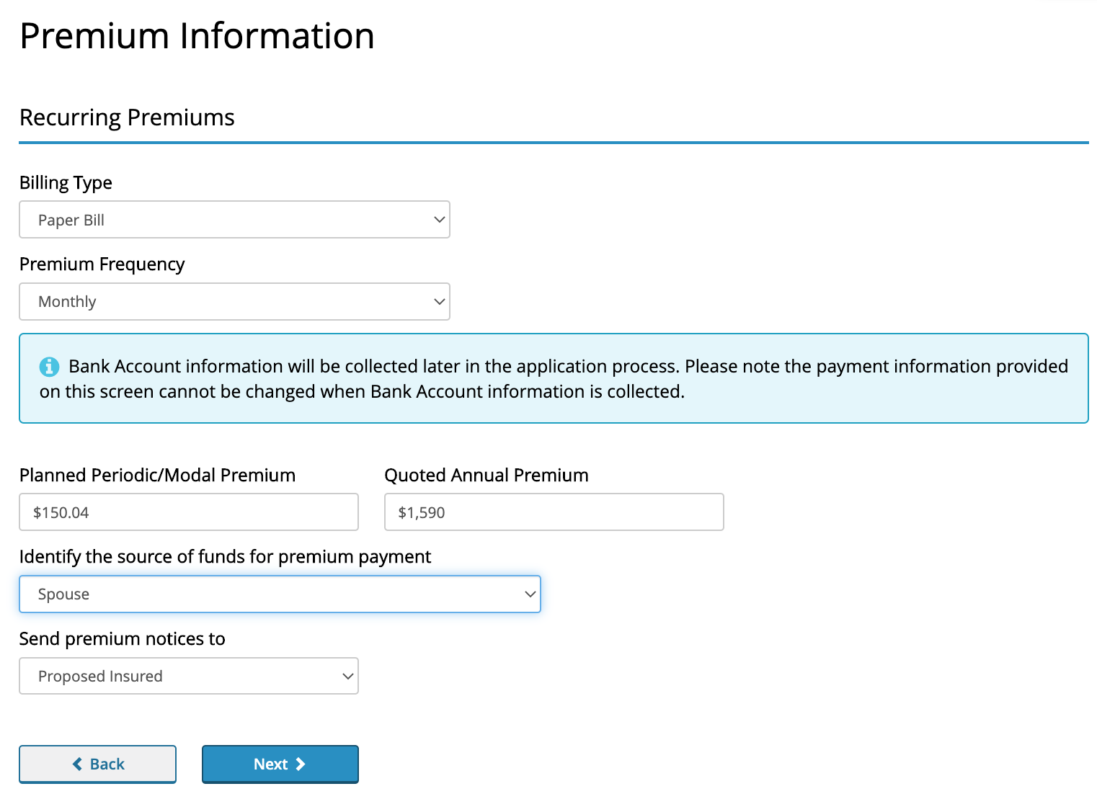
Common Reasons Apps Do Not Qualify for Straight Through Processing:
Additional Information
Helpful Hints:
▶︎
Premium Information – avoid choosing “other” when possible; “Spouse” has recently been added as an option.
▶︎
Do not order Labs & APS unless requested by the UW or required based on Age/Face amount:
EZ Underwriting limits are up to $3M for UL/IUL. Consult the Underwriting Guide for EZ Underwriting limits.
If LABS/APS required due to age/face, remember you’ll now see this through Instant Communication at application submission.

